Slide 1
Squad Up
Eric Jackman, Jacob Nelson, Pam Pepper

Slide 2
About Squad Up
Squad Up is an easy way of finding people interested in playing the same games as you.
It features:
User profiles – a place to describe yourself.
Groups – a place to join like minded gamers.

Slide 3
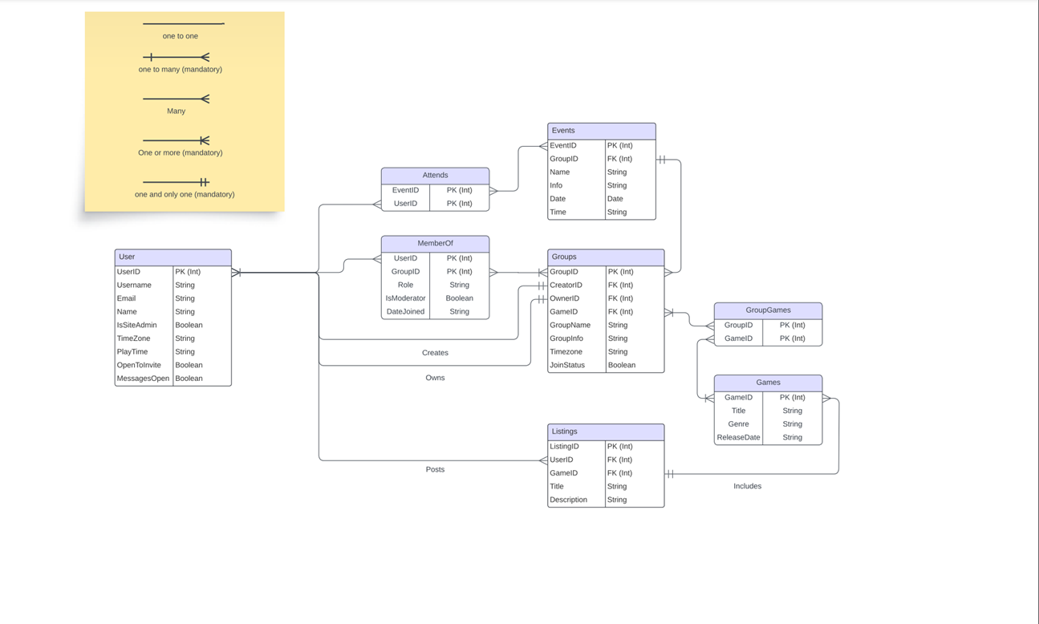
ERD

Slide 4
Contributions
Eric Jackman – PowerPoint presentation, authentication module, signup/login pages, group create/edit/delete/detail pages
Pam Pepper - Database implementation, profile page.
Jacob Nelson - Group finder page, group create/edit/delete/detail operations

